Slide 1
The Open Source Way 2.0
Guide for community management best practices
Karsten Wade @quaid
Sr. Community Architect
Open Source Program Office

Slide 2
Hi SCaLE 18x!
What we’re talking about today
The what - vision for this guide
The history - how we got here
The present - where we are today
The next - what, when, & who
AGENDA

Slide 3
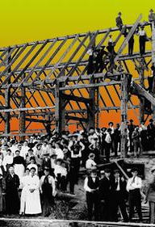
Create a community management best practices guide for open source practitioners, written by and from the experience of those same practitioners.
In the process foster a community of practice that will maintain and grow the guide.
THE WHAT
Notes:
Unvetted by others, help improve this vision!

Slide 4
TOSW 1.0 ~2009
Set out to say how to do what practice, but include the reasons why something is a “best practice”.
Write down the many things we repeat.
Last decade == evolution in open source development practices.
THE HISTORY
Notes:
This was work done from the original Community Architecture team that included Greg DeKoenigberg, Max Spevack, Mel Chua, and a host of awesome interns - Iliana Sebastian, et al. We literally started because we were tired of saying the same things to Red Hatters over and over, then quickly realized it needed to be an upstream project that lived it’s own ruleset. That gave the possibility of external contribution and collaboration on a better guide. Interestingly, no one else has picked up on the idea of a “community how-to book written by a community of practitioners using its own guidelines in doing so”.

Slide 5
Community 101 - how & why to start an open source community.
Attracting Users - what people want; getting them excited; driving adoption.
Guiding Participants - what they need/want; how they help the project.
Growing Contributors - identifying contributions; creating processes; lowering barriers; governance; community roles; managing code & content.
Community Manager Self-Care (NEW)
Measuring Success
Avoiding Pitfalls, Learning from Mistakes
THE PRESENT -- TOP-LEVEL GUIDE SECTIONS OUTLINE
Notes:
This is a fully new outline compared to the 1.0 version. Content from 1.0 will considered, adapted, and merged into these sections, often as part of a lexicon that wraps up each section/chapter.

Slide 6
Introductions
Community 101
Quickstart checklist (NEW)
Terminology and lexicon
Attracting Users
Basics of a project
Driving adoption
Guiding Participants
What participants want
How participants help
THE PRESENT -- DETAILED GUIDE CHAPTERS OUTLINE

Slide 7
Growing Contributors
What is a contribution
Getting organized
Onboarding
Easyfix to experienced (NEW)
Legal and governance
Community roles
Migrating code
THE PRESENT -- DETAILED GUIDE CHAPTERS OUTLINE

Slide 8
Community Manager Self-Care (NEW)
New section from FOSDEM BOF
Measuring Success
Defining healthy communities
Developing a metrics plan
Avoiding Pitfalls, Learning From Mistakes
Home to all the extra stories (NEW)
Proof and References
THE PRESENT -- DETAILED GUIDE CHAPTERS OUTLINE

Slide 9
Authoring in AsciiDoc using a GitHub workflow.
Going to where most potential contributors already are.
Discussions about content stays with the content.
THE PRESENT -- GIT REPO & WORKFLOW

Slide 10
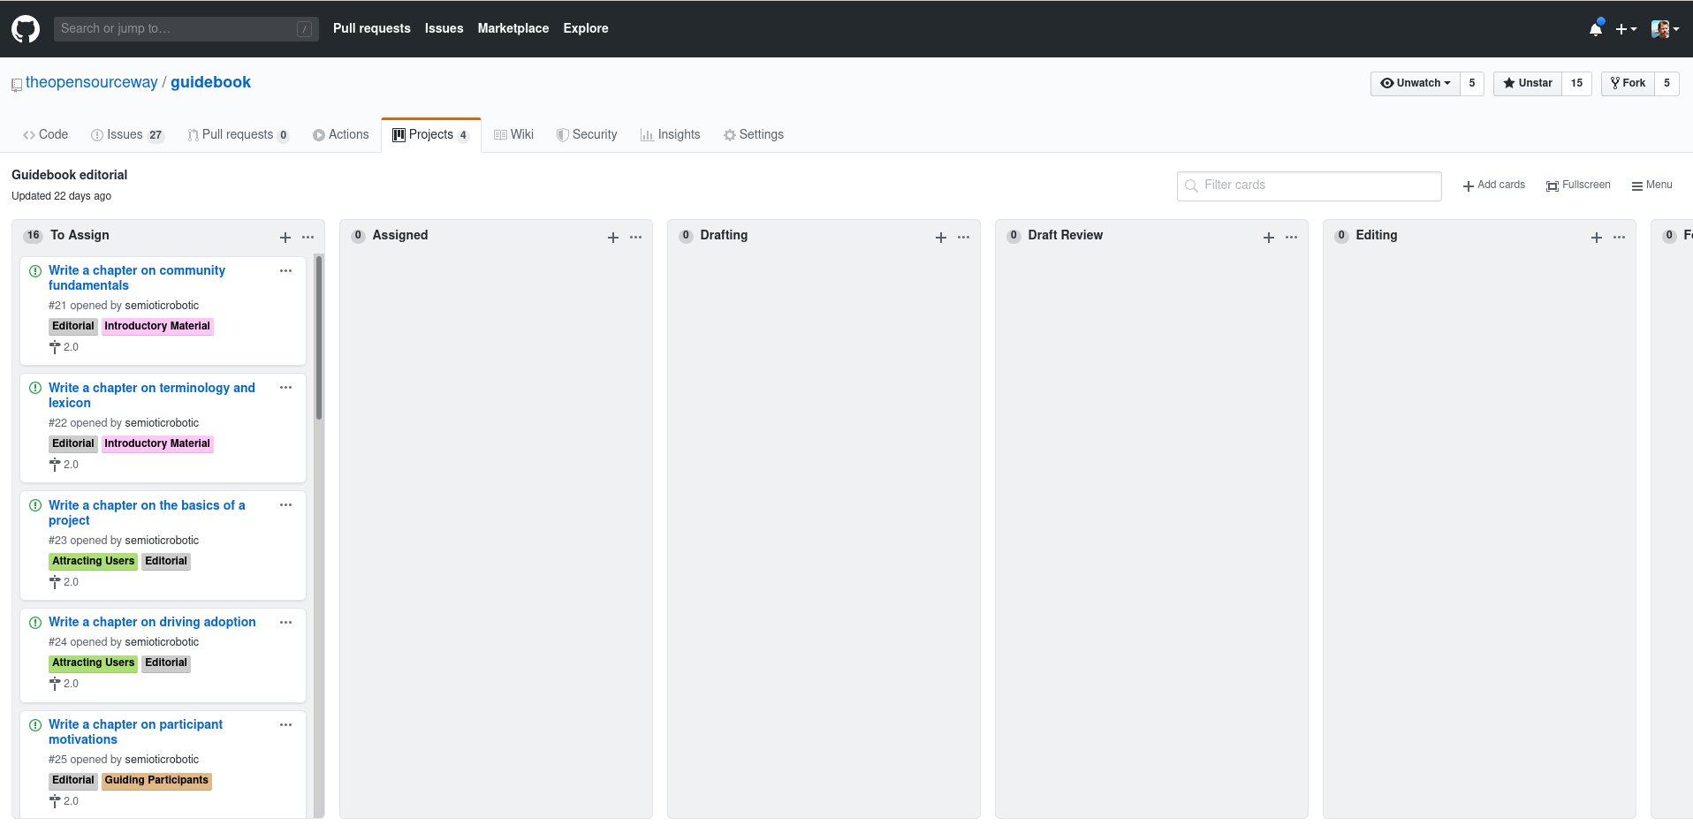
THE PRESENT -- GIT REPO & WORKFLOW

Slide 11
Meta-discussions happen on the forum/mailing list.
We’re holding open weekly video stand-ups to keep on track.
THE PRESENT -- COLLABORATION

Slide 12
Project Lead - Karsten Wade
Lead Editor - Brian Proffitt
Lead Writer - Shaun McCance
Editing team - Brian Proffitt, Karsten Wade, Shaun McCance, You?
Writing team - Bryan Behrenshausen, Brian Proffitt, Karsten Wade, Shaun McCance, You?
THE PRESENT -- WHO IS DOING WHAT

Slide 13
Put your interest in the issue in GitHub related to a chapter. Discuss on the mailing list your ideas.
Work on content in git, collaborate with other writers and Lead Writer.
THE PRESENT -- HOW TO CONTRIBUTE

Slide 14
Make a pull request for your chapter to merge from your branch to the guide.
Editor reviews and works with you on improvements and changes. Issue is used to track who “has the pen”.
THE PRESENT -- HOW TO CONTRIBUTE

Slide 15
Finalized work is merged into the main git repo by one of the Editing Team.
THE PRESENT -- HOW TO CONTRIBUTE

Slide 16
At FOSDEM, I promised a release date by the workshop yesterday.
Oops.
We should be able to finalize the milestone schedule by the end of March.
With your help?
THE NEXT -- RELEASE DATE
Notes:
Release date not set yet.

Slide 17
Demonstrate in execution what we advise
Month 1 to ~6 -- Karsten is temporary project chair/lead.
Month 3 - 6 -- Community develops new governance.
Month ~6 -- Adopt new governance.
THE NEXT -- PROJECT GOVERNANCE
Notes:
Final adoption of new governance should happen after the 2.0 release, so as to not change leadership and governance in the middle of working toward a release.

Slide 18
Questions? contrib@lists.theopensourceway.org lists.theopensourceway.org/archives/list/contrib@theopensourceway.org/ twitter.com/quaid
QUESTION & ANSWER

Slide 19
Thanks! community.redhat.com iquaid.org
Presentation & all images CC BY SA 4.0 github.com/theopensourceway/guidebook/blob/master/marketing/
QUESTION & ANSWER

Slide 20
Thank you
OPTIONAL SECTION MARKER OR TITLE
Red Hat is the world’s leading provider of enterprise open source software solutions. Award-winning support, training, and consulting services make Red Hat a trusted adviser to the Fortune 500.

